Slide 1
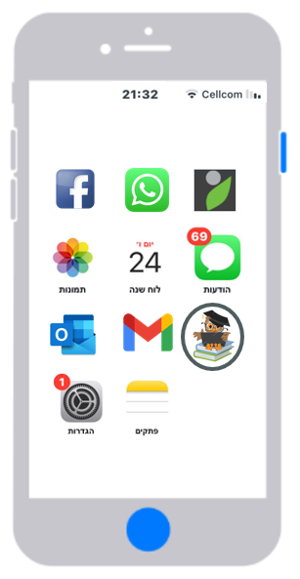

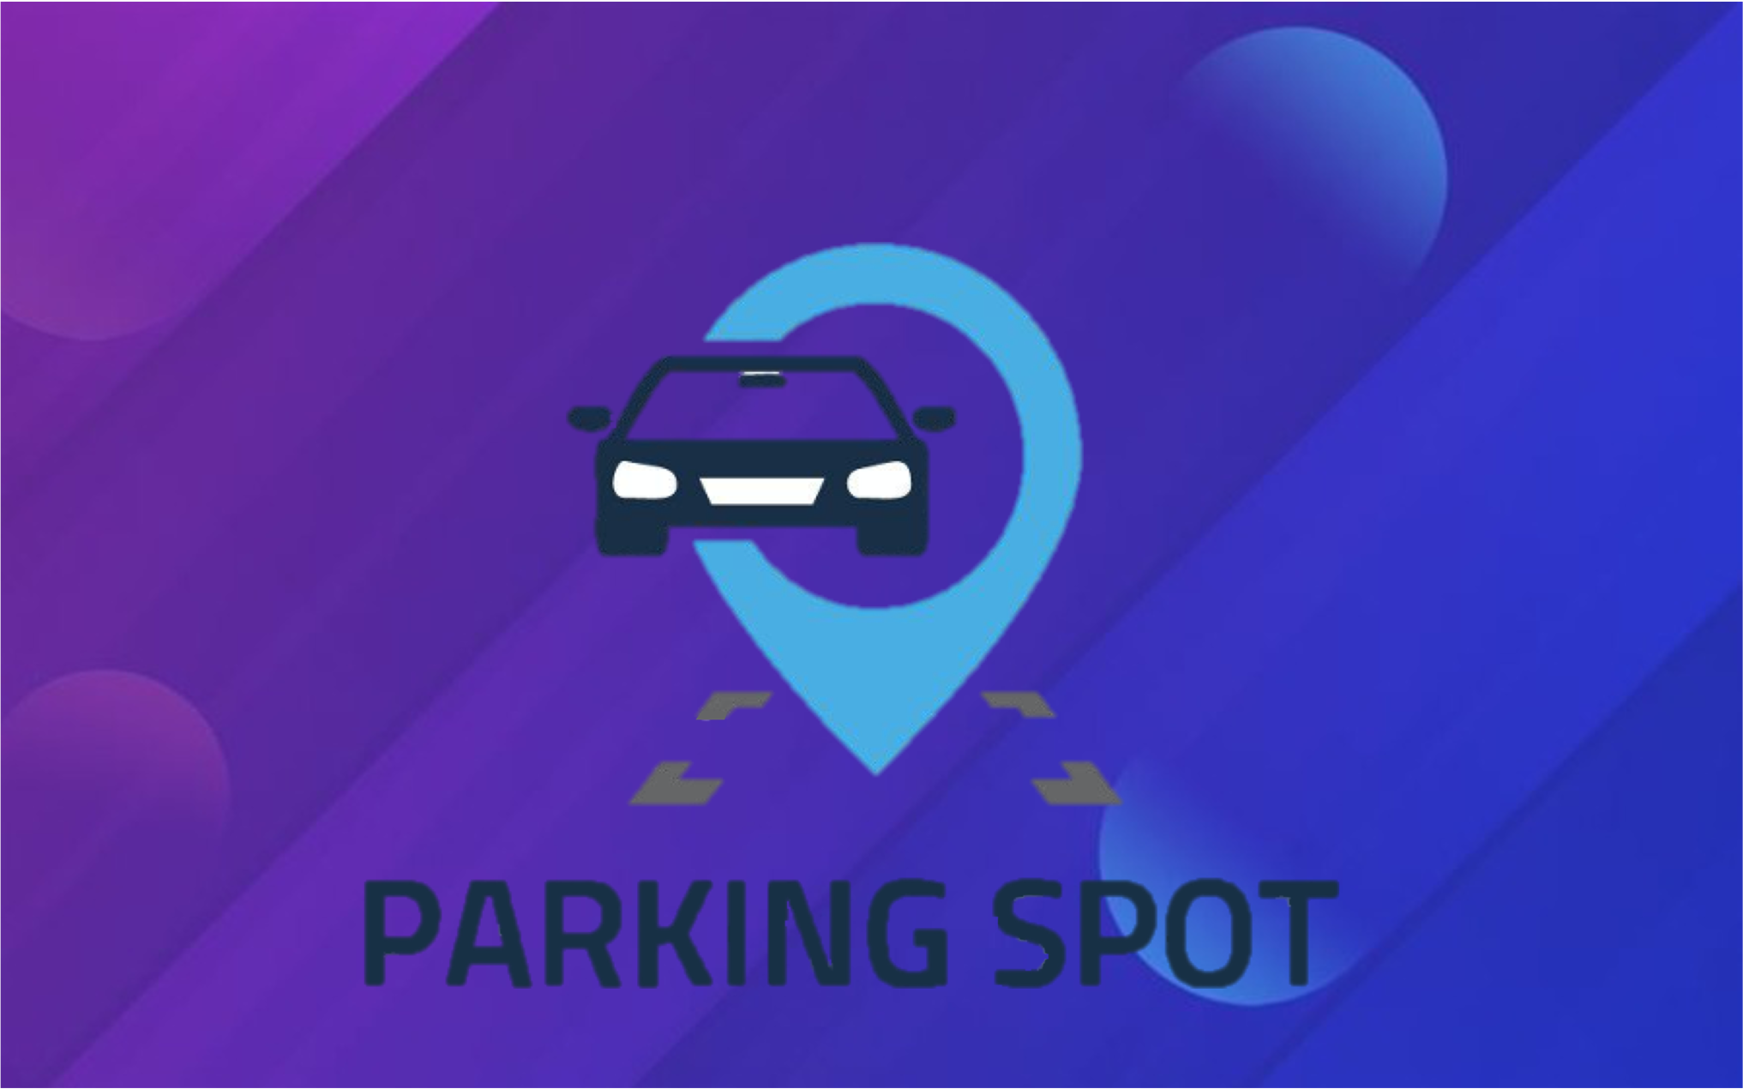
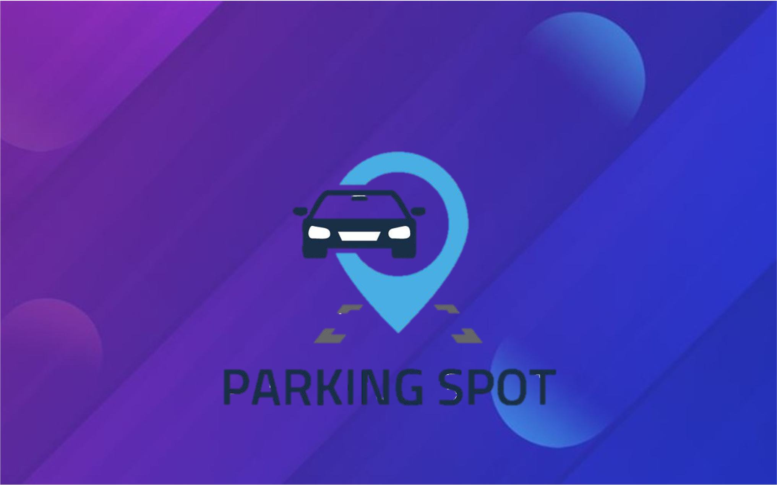

Parking Spot
Friendly Parking Spotting Application
Presented by:
Roy Vaygue
Shoval Shabi

Slide 2

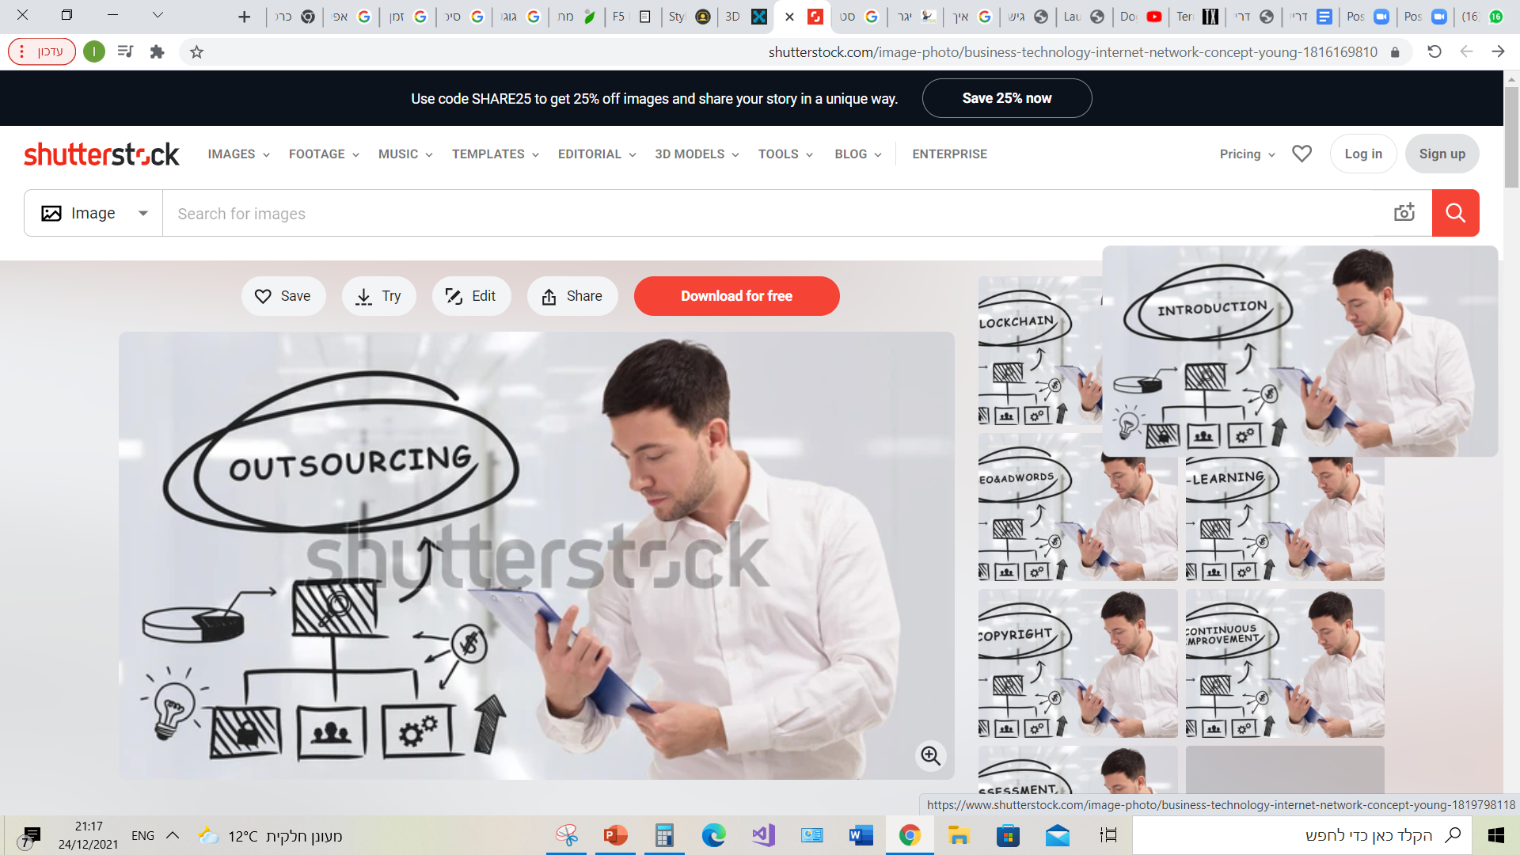
Friendly Application that helps you find a free parking spot next to your destination.
Introduction

Slide 3


Vision
An application that helps drivers to find a nearby parking spot which is free.
The application will be a form of social media, in order to establish a community of drivers that helps each other.

Slide 4

GOALS
Success Criteria | Objectives | Goal
Time measurement (how long will take a driver to find a parking next to a destination) | Providing information about parking spots | Save time to the drivers
At least 25,000 followers on every social network within 4 years. | Active social media program, promotions. | Build our brand
To gain initial profits two years (maximum) after launch. | Put in the app some commercials | Profitable service

Slide 5

Current State
Today there are two existing platforms that provide the need of finding instant parking spots but the main difference is that the parking spots in the app are all to rent (which means that for each spot you need to pay).
There is majority of parking spots within urban areas that are not part of parking lots or regulated places, so we decided to develop an app that fill the gap for this particular issue by allowing people to report on available parking spots they see, and by that the app increase the efficiency of the usage of parking spots and the time to locate it.

Slide 6
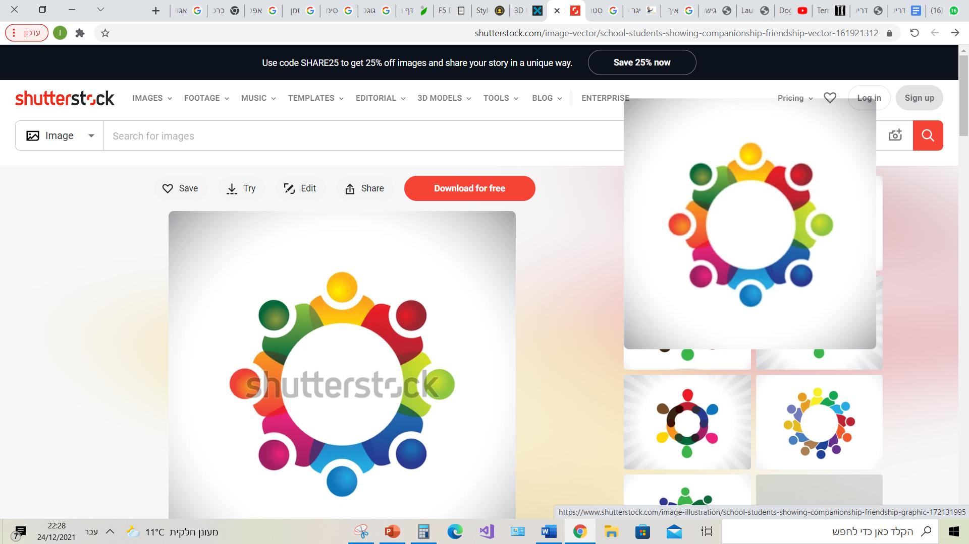

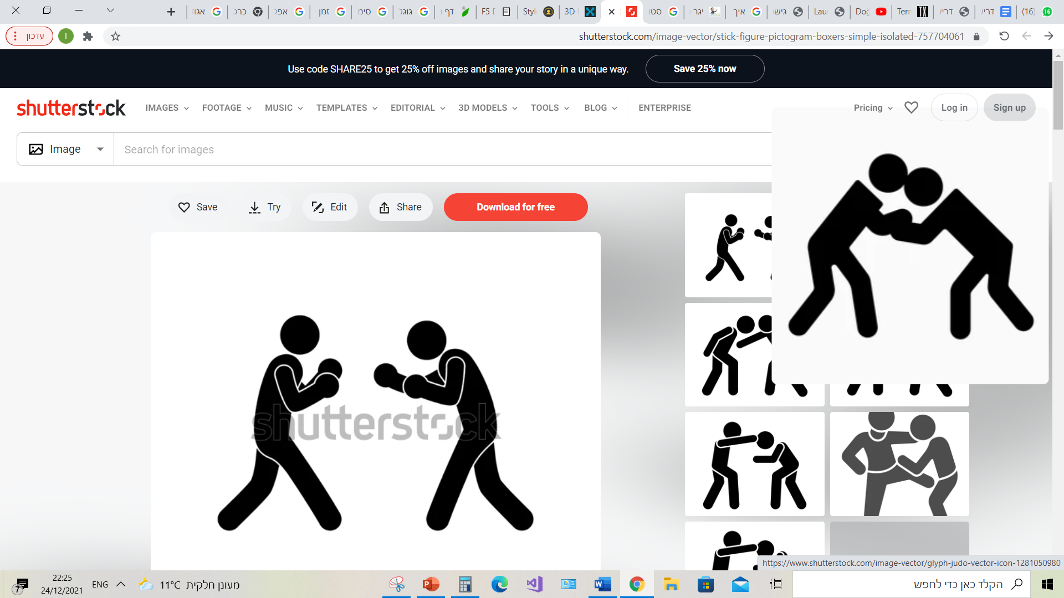

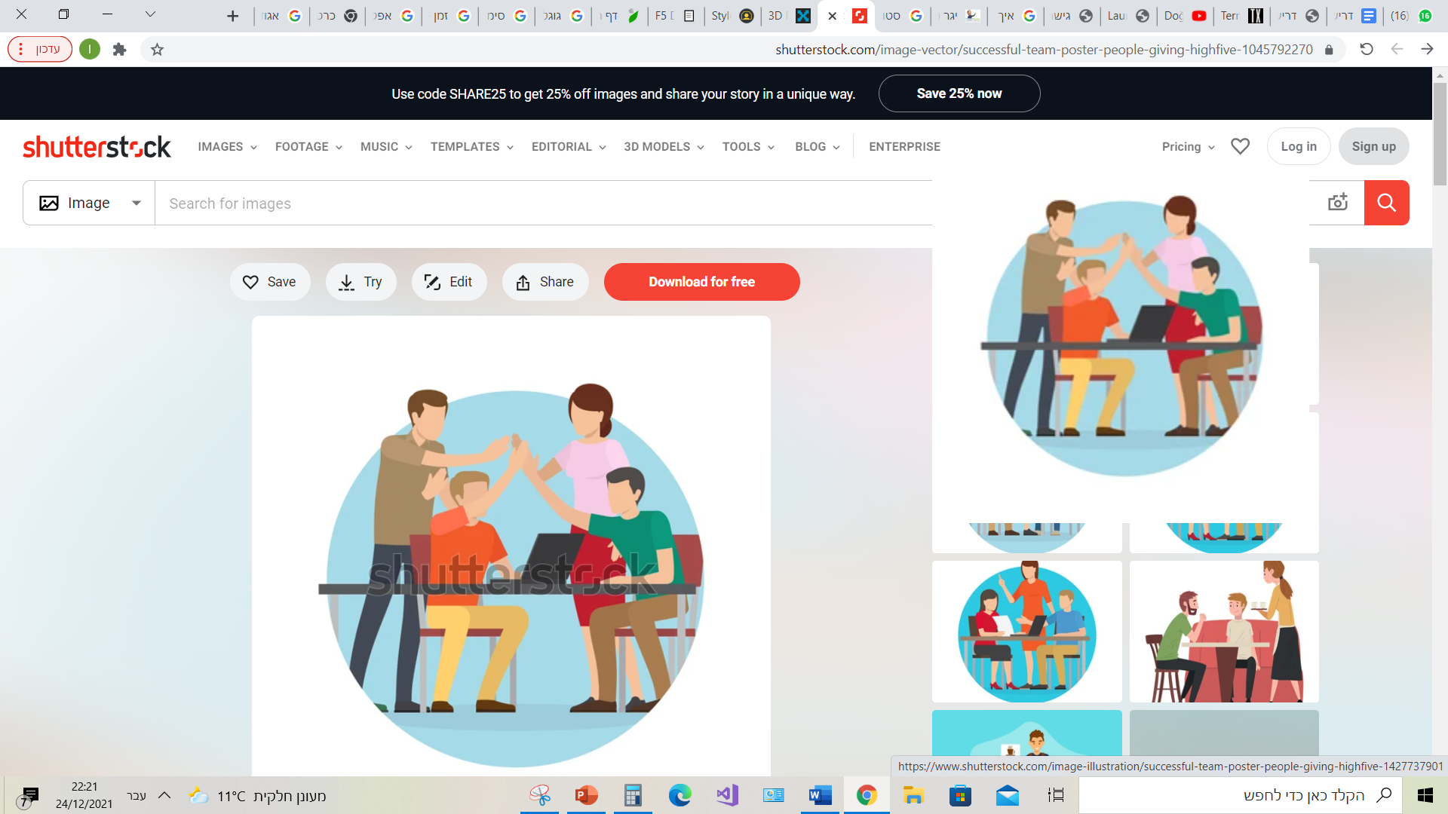

Countries and Municipality
Competitors
Stakeholder
users
System engineers

Slide 7

Stakeholder
Goal | Internal/ External | Name
Improve the current parking situation. | External | Countries and Municipality
All listings on the site should meet the site’s policies | Internal | System engineers / programmers
Get a platform that can help them find a parking next to their location. | External | Users (drivers)
Want to get the biggest share of the market. | External | Competitors

Slide 8



General educational institution
Server
Actors
User
Tabula

Slide 9

Actors
Goal | Description | Primary/ Support | Name
Enjoy daily services from the app. | A user that has access to the application | Primary | User
Be a light data application. | All the information and functions are made within it and sent back to the user. | Support | server
Be a profitable application. | From Taboola we will be able to put in the app customize advertising. | Support | Taboola

Slide 10

Functional Requirements
Report a parking
spot
Find your car
Find a parking spot
Moodaily
See all the reports
See your own reports
Like other users reports

Slide 11
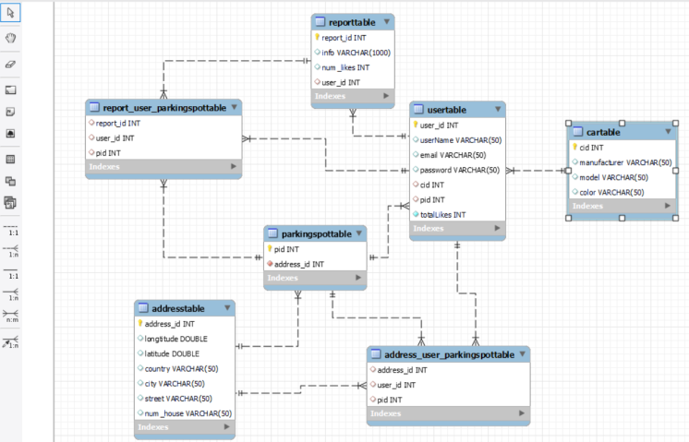
My SQL reverse engineering

Slide 12
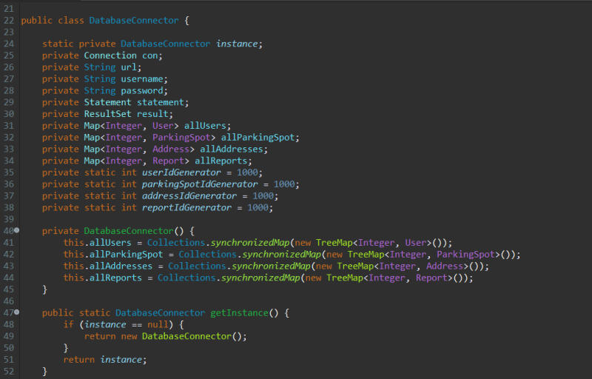
Singleton

Slide 13
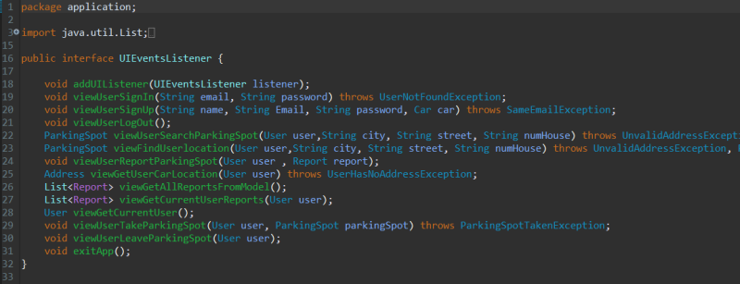
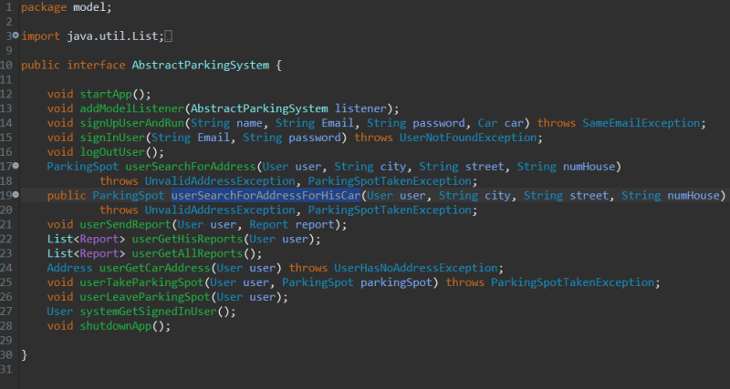
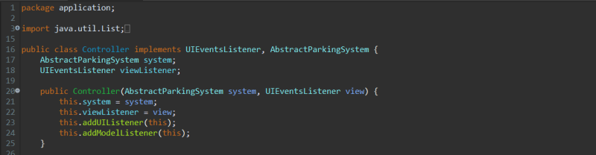
MVC

Slide 14
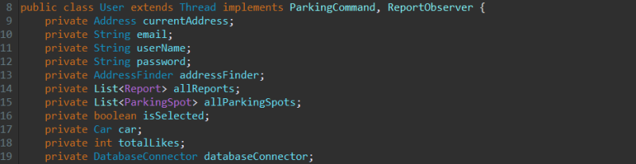
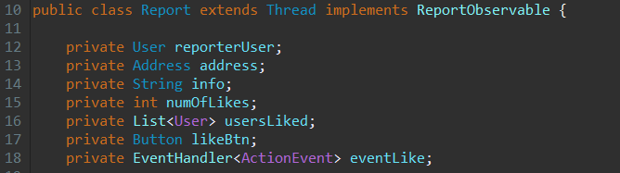
Composite

Slide 15
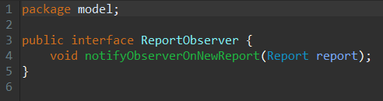
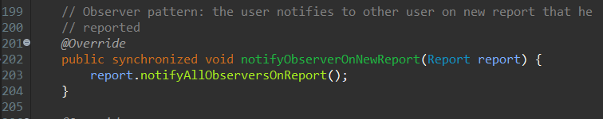
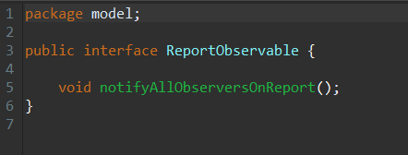
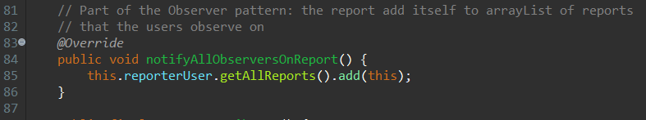
Observer

Slide 16
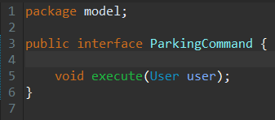
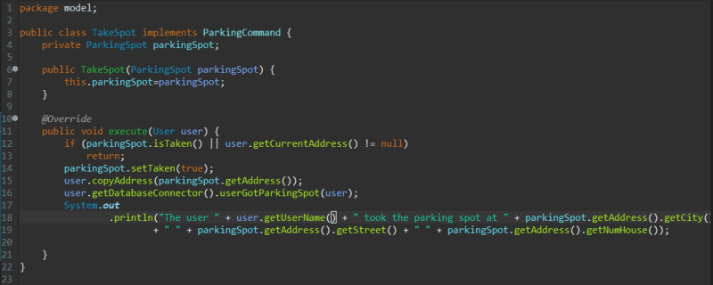
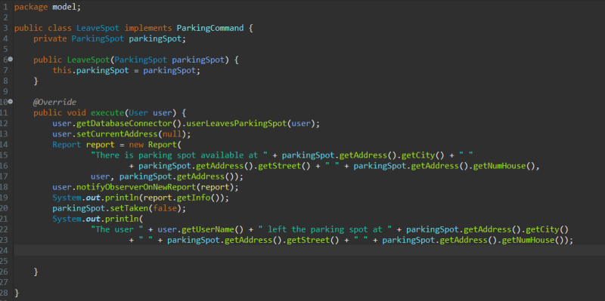
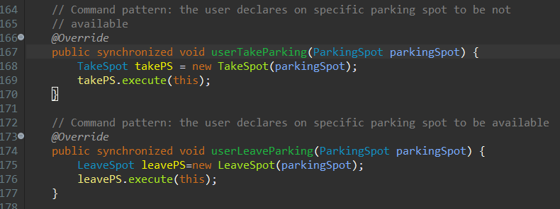
Command

Slide 17
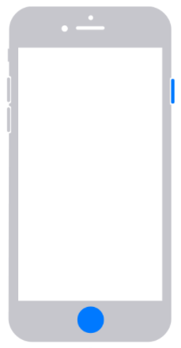
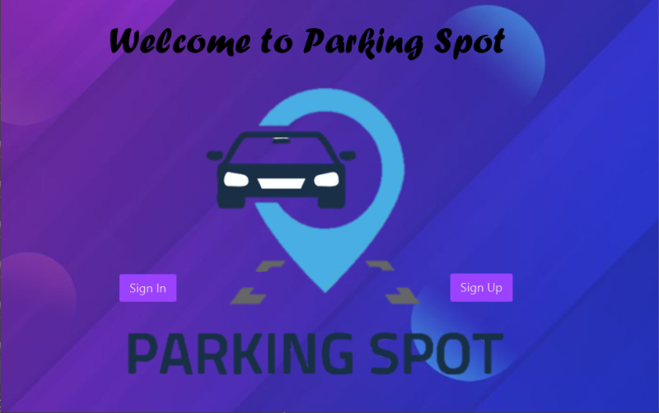
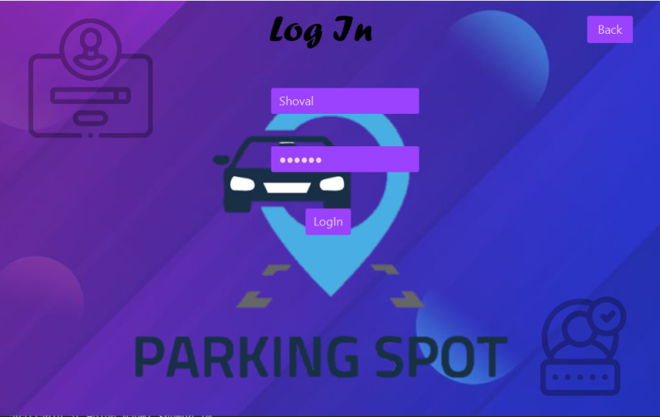
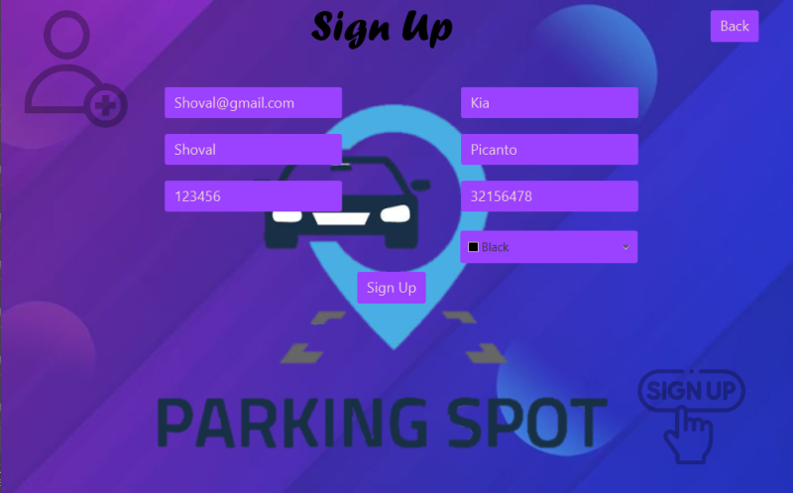
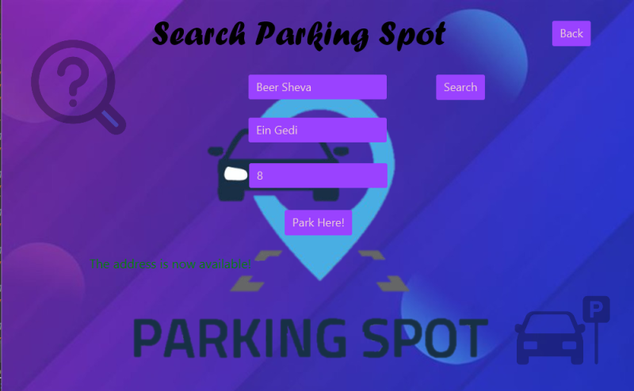
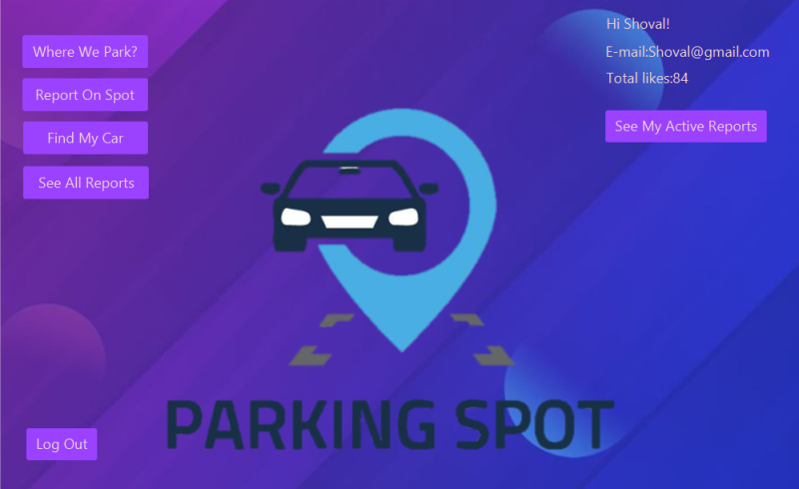
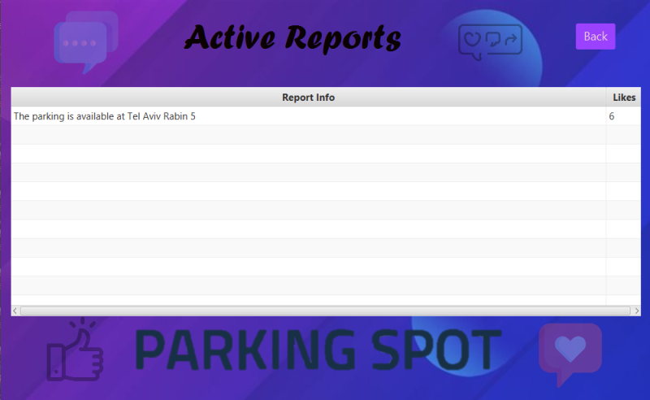
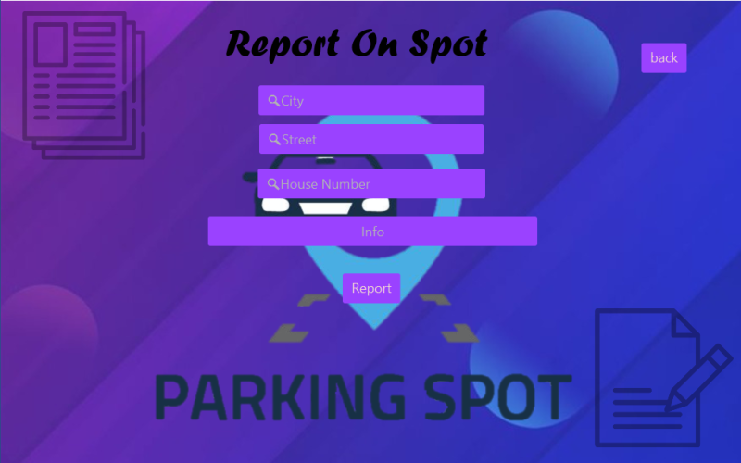
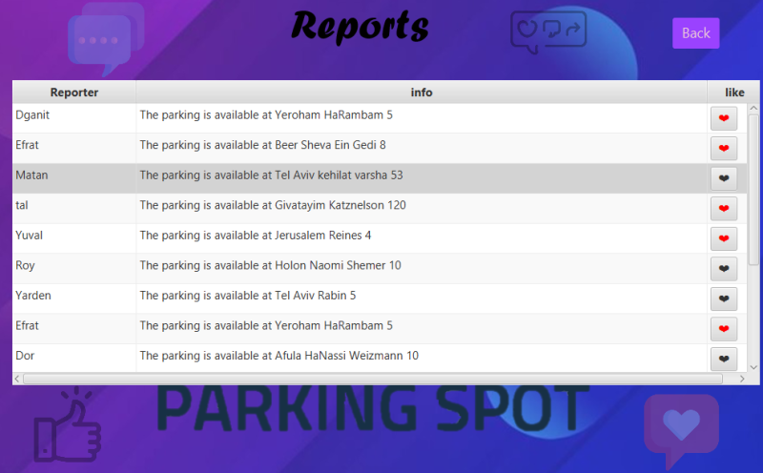
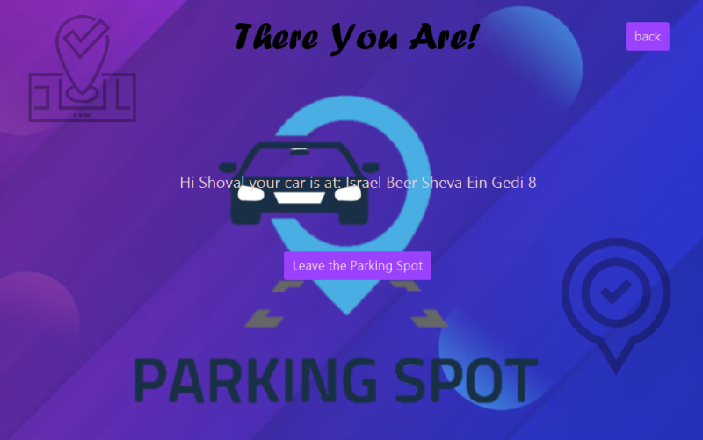
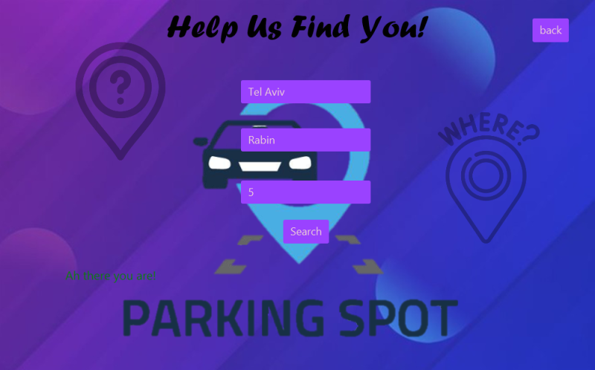
Has address
Has no address yet

